Slide 1


Bias in NLP
Investigating the Impact of Annotator Gender on Bias in Toxic Language Detection Systems
Elizabeth Excell

Slide 2
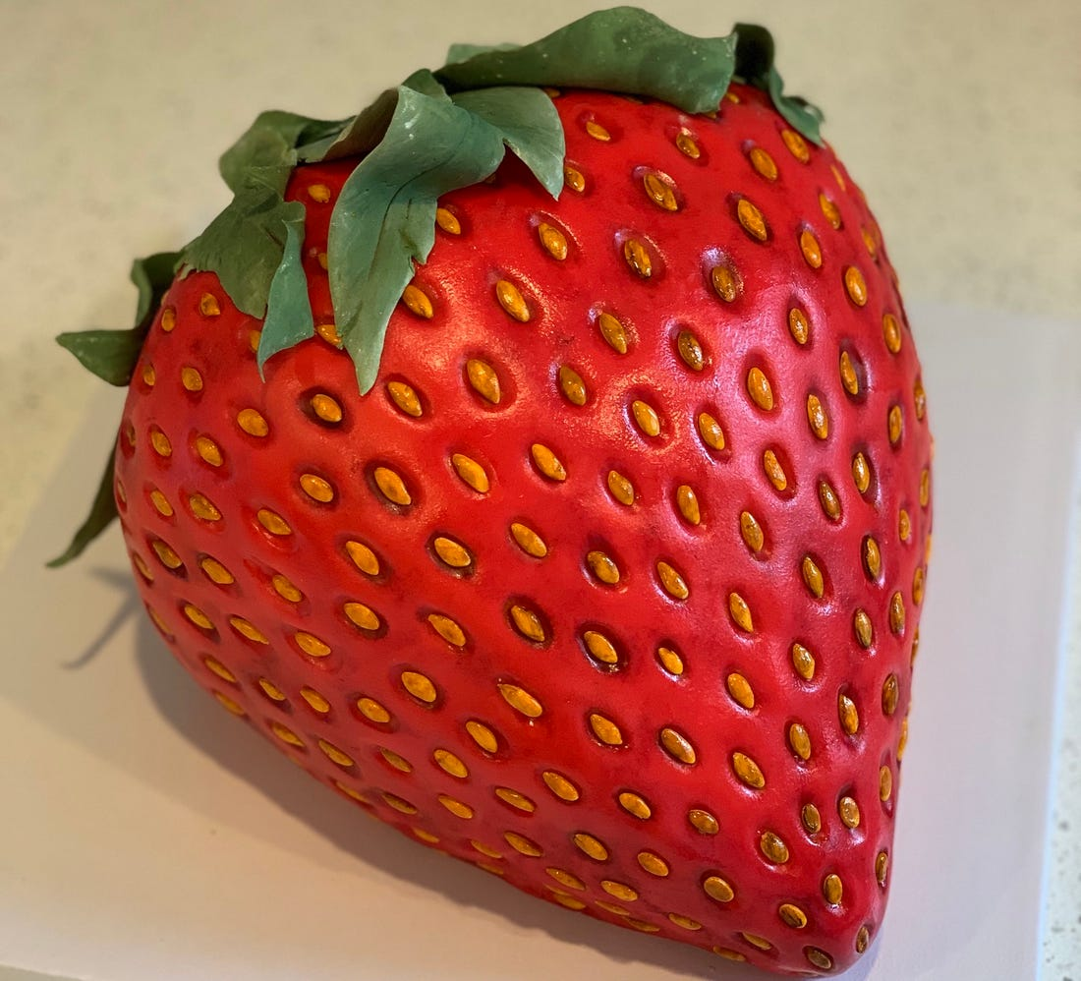
What is this? (Not a trick question)

Slide 3
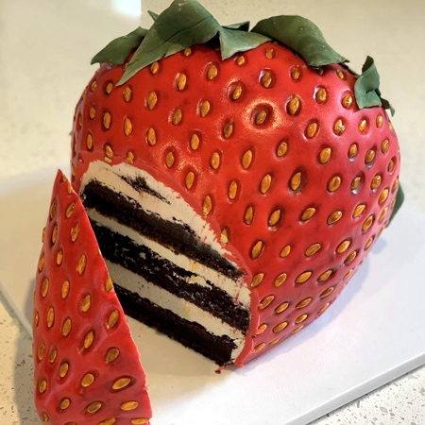

CAKE!

Slide 4
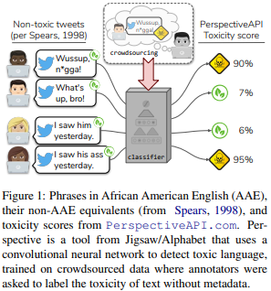
Other types of bias…
Sap, M., Card, D., Gabriel, S., Choi, Y. and Smith, N.A., 2019, July. The risk of racial bias in hate speech detection. In Proceedings of the 57th annual meeting of the association for computational linguistics (pp. 1668-1678).
https://www.aclweb.org/anthology/P19-1163.pdf

Slide 5
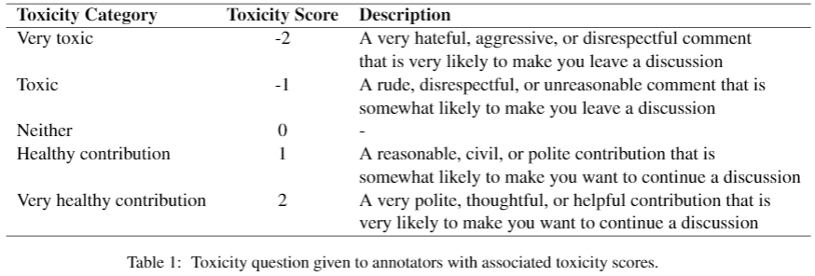
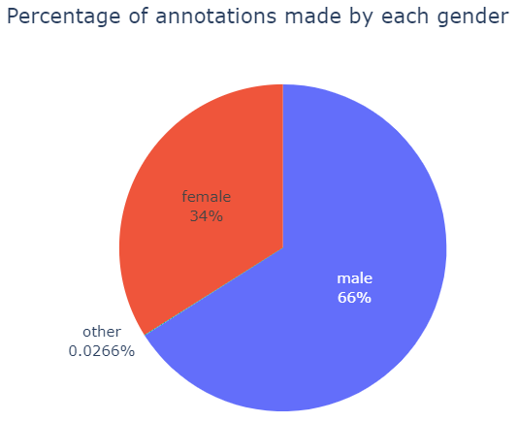
Dataset
160k comments from English Wikipedia
Female annotators on average classified 1.72% more comments as toxic than male annotators
Male annotators on average gave comments 0.048 higher scores (less toxic) than female annotators
Ellery Wulczyn, Nithum Thain, and Lucas Dixon. 2017.Ex machina: Personal attacks seen at scale. In Proceedings of the 26th international conference on world wide web, pages 1391–1399. https://dl.acm.org/doi/abs/10.1145/3038912.3052591

Slide 6
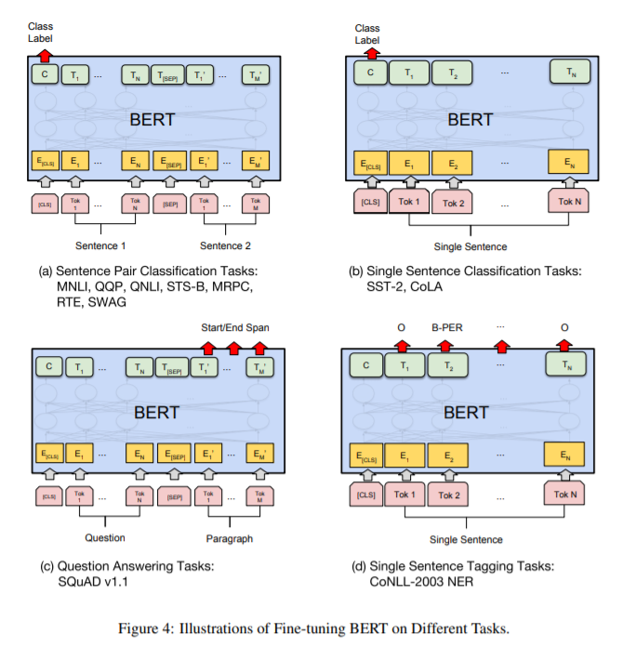
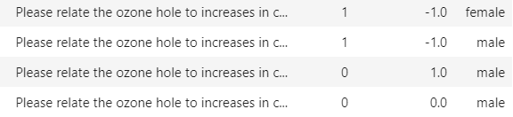

Gender Classification
Data:
Input:
Output:
Devlin, J., Chang, M.W., Lee, K. and Toutanova, K., 2018. Bert: Pre-training of deep bidirectional transformers for language understanding. arXiv preprint arXiv:1810.04805.
https://arxiv.org/pdf/1810.04805.pdf

Slide 7
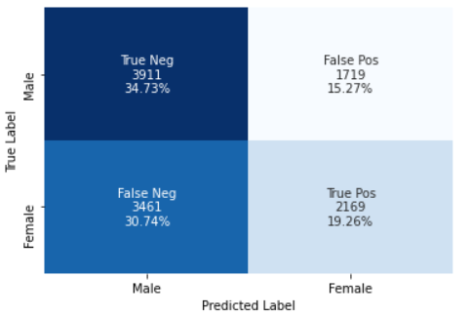
Results…how does this affect toxicity classification?
Bias towards predicting men as the annotators of toxic comments
Extra Information:
Men have a higher inter-annotator agreement than women
Classification relies on the majority opinion of the group
…but how to explain the results?

Slide 8
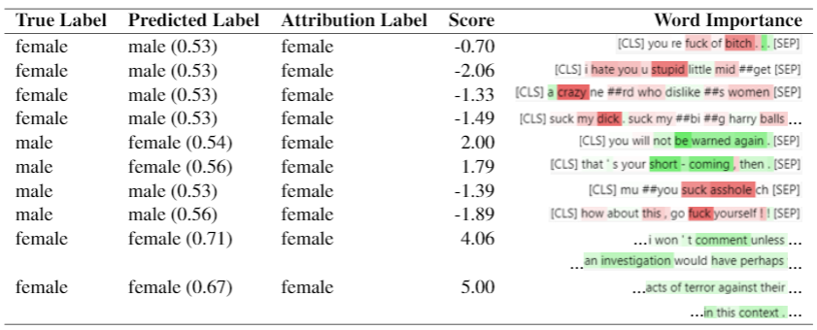
Remember the practicals?

Slide 9
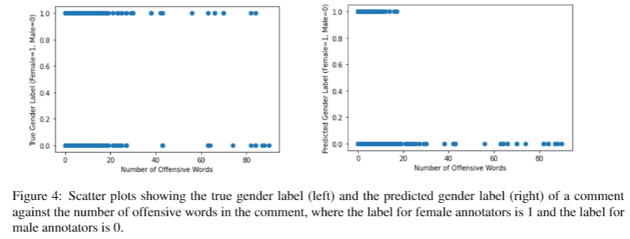
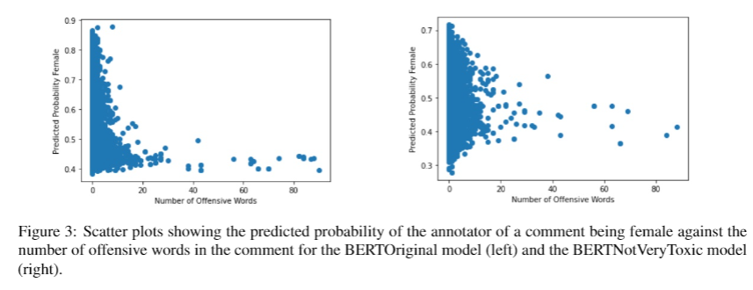
Validation
All comments annotated by women containing high numbers of offensive words are predicted as having been annotated by men
Gender predictions are more scattered once offensive words and the most toxic comments have been removed from the training data

Slide 10
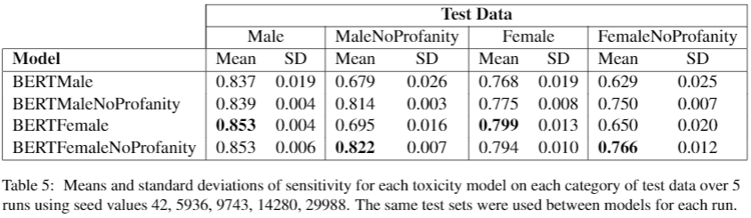
Toxicity Classification
Female test data performs worse than male test data
Female models perform better than male models
Test data without offensive words is harder to classify as toxic
Models trained without offensive words perform surprisingly well on all test data, always comparable to/better than their counterparts

